Slide 1
Welcome to Business Studies
Year 10 GCSE Business Studies
June, 2013

Slide 2
Learning Objectives
£ To recount how you will be assessed in Business within the next two years.
££ To apply your existing knowledge of Business to a given scenario.
£££ To evaluate the importance of Business Skills in life.

Slide 3
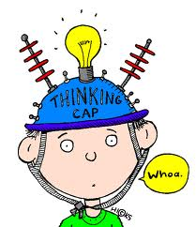
Starter Activity
Have a look at the object
Forget what it is NORMALLY used for…Can you think of an ALTERNATIVE use?

Slide 4
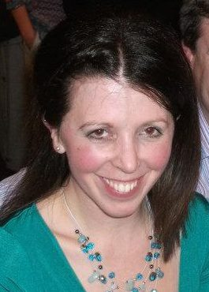
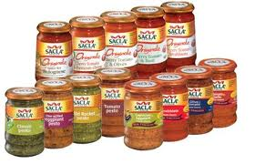
Who am I?
http://www.youtube.com/watch?v=xZk-UZqJnLI
Studies Business and Marketing at University
Worked in a Special Need’s School for 3 years
Do I want to run my own business one day? Yes!!!

Slide 5
Format of the Exam
Unit 1 – exam to be taken in June 2015
Setting up a business
Written paper (1 hour)
40% of your overall grade
Unit 2 – exam to be taken in June 2015
Growing a business
Written paper (1 hour)
35% of your overall grade
Unit 3 – Controlled Assessment
Similar to coursework
25% of your overall grade
Date to be completed - TBD

Slide 6
How to be successful in GCSE Business Studies

Slide 7
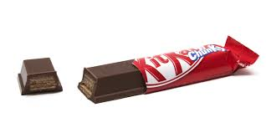
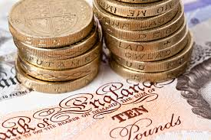
Choosing Business - a GOOD decision!

Slide 8
Mystery Guest

Slide 9
Who is Alan Sugar? (to be completed)

Slide 10
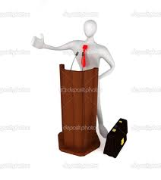
What Business Skills are you going to learn?

Slide 11
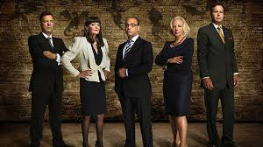
http://www.youtube.com/watch?v=DOaRzpYlIJM

Slide 12
Let’s see what you THINK you already know…
What is meant by ‘Business’?
What is the purpose of a Business?
What is the purpose of the programme ‘Dragon’s Den’?
Why do you think that some people want to start their own business?
Who can start up their own business?
What are people known as if they start up their own businesses?

Slide 13
Plenary

