Slide 1
Law 03 Reforms
Defences

Slide 2
Example Questions
Critically evaluate any two general defences (insanity, automatism, intoxication, consent, self-defence/prevention of crime). Suggest what reforms may be desirable to one of the defences that you have evaluated. (25 marks)

Slide 3
Mark Scheme
Potential Content
(A) Critical evaluation of first defence.
(B) Critical evaluation of second defence.
(C) Appropriate suggestions for reform in relation to (A) or (B). These should be related to the criticisms advanced and should, where possible, draw on substantial proposals (such as those made by Law Reform bodies and/or expert commentators).
[NB – credit should be given for any explanatory material on which criticisms are founded]

Slide 4
Mark Scheme
Possible areas for critical evaluation:
Insanity: the legal/medical notions of mental incapacity; relationship with diminished responsibility; limited nature of defect of reason; nature of disease of mind, including internal/external distinction and associated anomalies; uncertainty in scope and extent of required consequences (nature and quality/wrong); procedural aspects, including burden and standard of proof.
Automatism: definition of involuntariness (distinction between total and partial involuntariness); anomalies in distinguishing between insane and non-insane automatism; fault in becoming an automaton.
Intoxication: lack of clear rationale (defence or aggravation of offence); distinction between voluntary and involuntary intoxication; where voluntary intoxication, the specific intent/basic intent as crucial element in the approach; uncertainty in definition of specific intent; relationship with other defences (eg self-defence).
Consent: structure (strict basic rule + exceptions); lack of clear rationale for exceptions; true consent; anomalies in specific exceptions; exclusion from the exceptions (eg violence for sexual gratification).
Self-defence: general uncertainty in scope of reasonable force (eg mistakes, voluntary submission to danger of harm, carrying weapons and other possible preparation, pre-emptive force); excessive self-defence, especially in homicide (relationship with defence of loss of control); relationship with other defences, especially intoxication.

Slide 5
Mark Scheme
Possible suggestions for reform:
These could include matters such as:
the re-definition of the defence of insanity to achieve closer alignment with medical notions;
removal of the insane/non-insane automatism anomalies in the re-definition of insanity;
re-definition of the meaning of voluntary intoxication and its effect on criminal liability, including its effect on other defences;
re-structuring of the defence of consent and the provision of a clear rationale for the circumstances in which consent should be available (leading to re-consideration of the current inclusions and exclusions);
clearer proposals on the effect of excessive self-defence, avoiding a requirement for loss of self-control (as currently contained in the defence of loss of control); a more rational provision in relation to the effect of intoxication on the defence of self-defence.

Slide 6
Examiner’s Report
This question required candidates to choose, and critically evaluate, any two of the general defences. Additionally, candidates were then asked to suggest reforms to one of the chosen defences. Much as had happened when students answered a similar kind of question in an earlier exam series, so in this series students almost invariably observed these instructions in relation to the choice of two defences on which to offer critical evaluation. However, there were a significant number of answers in which students ignored the further instruction to present suggestions for reform in just one of the two chosen defences. Here, students made suggestions for reform in both defences, but only the stronger treatment could be credited.
It is also important to note that the question called for a critical evaluation. Whilst it is perfectly acceptable, and creditworthy, for such an evaluation to incorporate positive comment (it is argued, for instance, that the rules of law are clear and appropriate in their operation), it is unlikely that the higher marks can be achieved without some counterbalancing critical comments, especially in any area of law where powerful criticism is well known.

Slide 7
Moreover, there is little merit in answers which explain or describe the current rules and then simply assert their value without providing any more sophisticated analysis to support the assertion (the same could be said of alleged critical commentary which adopts the same approach, though it is perhaps a little more likely in such a case that some criticisms would have been identified, even if not properly developed).
Of the five defences available for selection, automatism was probably the least often chosen, whilst the others appeared to be about equally popular choices. The decision of most students to avoid automatism where one of their choices was insanity was probably rather wise, since students often found it difficult to distinguish clearly between the two. Consequently, answers which did attempt that combination often appeared to be discussing only one defence rather than two. (For this reason, I will not be doing Automatism very much with you.)
http://filestore.aqa.org.uk/subjects/AQA-LAW03-WRE-JAN13.PDF

Slide 8
Insanity

Slide 9
Examiner’s Report
In relation to Insanity, there were strong (though sometimes rather ‘all-purpose’) criticisms of the antiquated definitions, inconsistency with current medical interpretations, and the consequent uncertainties in the scope of the coverage of the defence. Additionally, students frequently commented on the failure of the rules to afford a defence in the context of ‘irresistible impulse’, the incidence of the burden of proof (and a potential conflict with the requirements of the European Convention on Human Rights), the stigma which allegedly attaches to a finding of not guilty by reason of insanity and makes the accused reluctant to use the defence, and problems relating to disposal consequent upon such a finding. Suggested reforms were often based upon the proposals of the Butler Committee and some students were adept in following the proposals through their subsequent history.

Slide 10
Obsolete and misleading
INSANITY has been criticised as a general defence as early as 1953 when the Royal Commission on Capital Punishment said the rules were OBSELETE AND MISLEADING because the rules date back to the 1843 case of M’Naghten. This is backed up by the significant improvement in medical understanding of conditions such as diabetes (Quick) and epilepsy (Hennessey ) which in most cases can be easily controlled by drugs and/or diet.
But Insanity still treats these D’s as a threat to the public which is clearly based on a set of archaic rules of disease of the mind dating back to Victorian times.

Slide 11
Defence is too narrow
The defence is criticised as BEING TOO NARROW as it excludes some of the very cases it originally seeks to protect society from. Clearly cases like that of Byrne, a psychopathic killer and Johnston who suffered from paranoid schizophrenia required the disposal structure arising from the special verdict of being found NG by reason of insanity (Criminal Procedures (unfitness to Plea) Act 1991), so that they could be forced to be treated for their conditions until they were regarded as no longer being a threat to the public.
However, Irresistible impulses (Byrne) and an admission by Johnston (confirming an earlier 1959 ratio in Windle) prevented the use of the defence as the Ds knew the nature and quality of their act, i.e., Byrne knew it was legally wrong to kill but just couldn’t help himself with his mental condition.
(Think about Diminished Responsibility (2009) as a reform to those that commit murder)

Slide 12
Internal/external cause
The defence of Insanity has been criticised for using the legal fiction of an INTERNAL CAUSE to decide on what is a disease of the mind. This has resulted in classing certain types of D’s as insane, such as sleepwalkers (Burgess) and even those suffering from arteriosclerosis (Kemp), who clearly are not those recognised by either the public or the medical profession as such. For diabetics the situation is further complicated dependant on whether the state was caused by hypoglycaemia (too much insulin), deemed as an external drug induced condition and automatism (Bailey), or hyperglycaemia (not enough insulin) considered by the courts to be a disease of the mind and an internal cause.
The diabetic who suffers from an internal cause then has the social stigma of being classed as legally insane and forced to submit to treatment, such as a hospital order, whereas the automatic state is classed as one where the D has total loss of control and a total acquittal. Clearly an injustice has been served on the D with an internal cause in this situation as no one would class him as being insane as diabetes can be easily controlled by drugs.

Slide 13
Right to detain indefinitely
The COURTS RIGHTS TO DETAIN THE D INDEFINATELY have been criticised (particularly under the disposal for murder) as it is said to breach Art 5 (right to liberty) of the Human Rights Act as D’s detention has not been reached through the rules on insanity based on objective medical opinion but only a legal one.
According to the case of Winterwerp (1979) this is an infringement of a person’s human rights and in the example diseases listed clearly such a disposal would go against all common sense and justice, yet the defence still operates without reform.

Slide 14
Presumption of innocence until guilt proven
Insanity has been criticised as the M’Naghten rules work contrary to a PRESUMPTION OF INNOCENCE UNTIL GUILT is proved under Art 6 Human Rights Act – the right to a fair trial. This is because where the D raises the defence the burden of proof is on him to show he is insane, though this is partially mitigated by a lower standard of proof (BOP).
In this situation the P do not have to prove the MR of the offence and if D fails to prove insanity then the D is guilty of the offence based only on the proof of the AR by the P, even if reasonable doubt exists as to the MR of the offence.

Slide 15
Reforms
REFORM of the defence has been suggested by the Butler Committee on abnormal behaviour in 1975 where proof of severe mental disorder was suggested as being sufficient to negate responsibility. This would create a presumption of no criminal responsibility where there is proof of a severe mental disorder. However, this assumes a lack of criminal responsibility simply because there is evidence of some sort of mental dysfunction, rather than establishing a standard of criminal responsibility. This then questions the application of the defence to all crimes rather than those involving mens rea.
The Law Commission’s (LC) draft criminal code in 1989 (and more recently the 2011 project instigated on Unfitness to plea and the insanity defence) clearly recognise the weaknesses of the current law with the LC steering a course for a defence based on mental disorders and clear medical evidence rather than the archaic principles of the current defence. The government has made no specific response but with the recent amendments to DR and the very low level of pleas each year (less than 10) in practical terms the impact of reforms perhaps outweigh the parliamentary time needed to place this defence in a satisfactory state as a priority. http://www.lawteacher.net/PDF/Insanity%20Lecture%202.pdf

Slide 16
Draft Criminal Code
https://www.gov.uk/government/uploads/system/uploads/attachment_data/file/228596/0270.pdf
Page 102
Butler Committe
http://en.wikipedia.org/wiki/Butler_Committee
Recommendations

Slide 17
Examiner’s Report
Most criticisms of the defence of Automatism focused on the extent of the loss of control required to raise the defence, illustrated by a case such as Broome v Perkins, and on the difficulties attending the distinction between external and internal causes. This also brought into play the close connection between the defence of automatism and the defence of insanity. Suggestions for reform were invariably simplistic and called for the removal of the distinction between internal and external causes in respect of diseases such as diabetes.

Slide 18
Automatism
The law on automatism and insanity is currently being examined by the Law Commission. Automatism has been described as a “quagmire… seldom entered nowadays save by those in sesperate need of some kind of a defence ” (Lawton LJ in Quick ). The need for reform has been recognized for some time, and here are some of the suggestions that have been made.

Slide 19
Abolish the internal/external divide doctrine
Under this doctrine, automatism with an internal cause is deemed an insaneautomatism and therefore defined by the
MacNaughtan Rules
and leading to thespecial verdict
.
If there is an external cause, it is deemed a sane (or non-insane)automatism and leading to a plain acquittal.This doctrine is the most problematic for medical expert witnesses. Many medicalconditions are a combination of a predisposition and a trigger, and therefore acombination of internal and external factors. The internal/external divide leads toanomalies, one notable example being in the case of a person with diabetes (
Quick
).If he either takes too much insulin, or neglects to eat or drinks alcohol, he may suffera hypoglycaemic episode (low blood sugar) which being triggered by theadministration of a drug is deemed to be a sane automatism. If he neglects hiscondition and fails to take sufficient insulin and becomes hyperglycaemic (high bloodsugar), this is deemed an insane automatism, similarly if he suffers hypoglycaemiadue to an insulin-secreting tumour.The other difficulty with this distinction is directing the jury when either insane orsane automatism is a possibility. See Appendix 1 for part of direction given in court.
The terminology of „insane automatism‟ even confuses lawyers, as the direction
below demonstrates.If there is no distinction between the two, either all cases of automatism will have tobe pleaded under the special verdict (or an alternative defence used e.g. lack of
mens rea
) or some other criterion will be used to distinguish between sane andinsane automatism e.g. risk of recurrence or risk to the public. The criterion ofdangerousness is used in Canada (see
Rabey
and
Parks
). This would provide abetter rational to the decision, understandable as it was, in
R v T.

Slide 20
Change disposal powers
Judges have very flexible disposal powers in the Criminal Procedures (Insanity andUnfitness to Plead) Act 1991. However, those accused of homicide and acquitted bythe special verdict must receive a hospital order, if they have a mental disorder. It is
not known if sleepwalking would be considered a mental disorder (and this is oneinstance where the decision might be made on a case by case basis).

Slide 21
Restrict the ambit of (sane) automatism
The Butler Committee proposed restricting sane automatism to „transient states not
related to other forms of mental disorder and arising solely as a consequence of (a)the administration, maladministration or non-administration of alcohol, drugs or others
ubstances or (b) physical injury‟ (para 18.23).
This would not eliminate the diabeticanomaly mentioned above.
Other suggestions are to restrict it still further to “reflex,spasm or convulsions” as per the first part of Clause 33(1) of the Law Commission‟
sDraft Criminal Code (this would make the definition of legal automatism and medicalautomatism virtually identical). This has been suggested in combination withwidening the ambit of the insanity defence. This would have the arguable advantageof requiring the defence to prove the defendant was sleepwalking etc.
The problem with this approach is the stigmatising label of “insanity”. This is already
an issue with epilepsy and other conditions. The solution which has been advocatedfor some time is to change the name of the defence. For example in Canada it is
now the defence of being „not criminally responsible on account of mental disorder‟
(NCRMD). Even this is not wholly satisfactory, given the number of physicalcomplaints that can cause legal insanity.

Slide 22
Intoxication

Slide 23
Examiner’s Report
The most frequent criticisms of Intoxication concentrated on the distinction between specific and basic intent crimes (which was perceptively identified as the crucial mechanism for determining policy), the alleged injustice in the case of Kingston, the difficulty in reconciling the demands of the Majewski decision with the requirement for coincidence of actus reus and mens rea, the anomalies arising out of the application of the intoxication rules in circumstances where self-defence is pleaded (O’Grady, Hatton), and the absence of associated basic intent crimes in many important specific intent offences. In discussing reforms, many students succeeded in referring to the Law Commission Report (LC314), Intoxication and Criminal Liability, 2009, though few were able to give any convincing account of the proposals which it contains.

Slide 24
Distinction between basic and specific intent offences
The DISTINCTION BETWEEN SPECIFC AND BASIC intent crimes and the use of the defence has been criticised as being too simplistic an approach. The general law takes a subjective approach to mens rea. If there is no subjective mens rea there should be no liability as can be seen in the case of R v G and R (2003), where as the boys were not aware of the risk of criminal damage they were said not to be reckless. The case of Majewski (1977) ignores this subjective approach for basic intent crimes, which are normally high in volume, the moral questionability of getting drunk is seen as a reckless course of action in itself so the defence is unarguable. Where the D is charged with murder or S18 he can use the defence of intoxication, even if voluntary, as these are specific intent crimes. If the D is found not guilty there are fallback offences of manslaughter and S20 for which the D is likely to be found guilty under the Majewski rules.
However for other offences there is often no fall back offence if a D is found not guilty of a specific intent crime which seems to allow a culpable D to have an unfair advantage if he is lucky enough to ‘choose’ such an offence, e.g. Theft
The distinction therefore requires judges to decide whether each criminal offence is one of basic or specific intent. This seems not to be settled as can be appreciated from the appeal in the case of Heard (2007) where the court had to decide if the offence of sexual assault contrary to s3 of the Sexual Offences Act 2003 was one of specific or basic intent. It seems surprising that Parliament does not make it clear in drafting an Act. There are also some bizarre anomalies – for example attempted rape is a crime that can be defended by a plea of intoxication, rape cannot.

Slide 25
Law based on public policy
The defence is also criticised as it is TOO MUCH BASED ON PUBLIC POLICY. Over the last 30 years public policy has become the main theme of law on intoxication not truly balancing the proof of fault on behalf of the D. For example parliament has enacted the Criminal Justice and Immigration Act 2008 that states for self-defence D cannot rely on ‘any mistaken belief attributable to intoxication that was voluntarily induced’.
Majweski has been heavily criticised for allowing the defence to prove the intoxicated state of D at sometime up to the crime as a replacement for proving the actual MR of the specified offence. This ignores one of the key principles of criminal law that D must be proved to have the MR of the offence before proven guilty and that this should coincide with the AR.

Slide 26
Creates inconsistencies across a range of other defences
Intoxication has also been criticised for DEVELOPING INCONSISTENT RULES ACROSS A RANGE OF OTHER DEFENCES. In Richardson and Irwin (1999) the defendant students were messing around after drinking and held their friend over the balcony of his room. Unfortunately he fell and was severely injured. The court decided that the jury should consider the effect of alcohol on the consent to this horseplay in the defence of consent.
This seems at odds with other defences such as self defence, where cases such as O’Grady and Hatton have specifically excluded a mistaken belief as to the use of force for self defence where intoxication is at the root of the mistake. In the defence of insanity, if the defendant’s drink or drug taking produces a disease of the mind he can be found insane under the M’Naghten rules. This was discussed in the early case of Davis (1881) and approved in both Beard (1920) and Gallagher (1963).
So besides being a defence that can be particularly harsh on the action of a D that most of society takes part in, drinking alcohol, it is a defence that lacks a truly consistent approach.

Slide 27
Lowered inhibitions
A final area where the law is in need of reform is where the D’s INHIBITIONS ARE BROKEN DOWN by being made intoxicated involuntarily. The decision in Kingston 1994 makes the D guilty as he was held to have formed the MR.
This ignores the fact that the D was not to blame for being intoxicated and such a D would not be guilty of a basic intent crime where the P relied on recklessness (Hardie 1984). This appears to be unfair to Ds in Kingston’s situation.

Slide 28
Reforms
In 1975 the Butler Committee proposed REFORM by creating a new offence of ‘dangerous intoxication’. The idea was that where the D was acquitted of a serious offence the D would alternatively be guilty of ‘dangerous intoxication’, with a maximum sentence of 3 years. This was aimed at balancing public protection and the D’s rights. However, this proposal was rejected, as the offence did not distinguish how serious the original offence had to be to trigger a charge.
In 1993 the LC proposed that evidence of voluntary intoxication should be available for all offences on the issue of MR. This would allow the D to be acquitted if he did not have the necessary MR and effectively gets rid of the Majewski rules.
A separate offence of ‘Criminal Intoxication’ similar to that suggested in 1975 was also proposed. The idea was abandoned and in 1995 the LC proposed codifying the present law as it stood, including the Majewski rules, which it felt operated ‘fairly, on the whole and without undue difficulty’, with the 1998 government backing this proposal.
One further proposal is to create a list of those situations where the courts can accept the intoxication was involuntary. However this bill has not been enacted and the law remains to be developed by case law.

Slide 29
Law Commission Report
http://lawcommission.justice.gov.uk/docs/lc314_Intoxication_and_Criminal_Liability.pdf
Look at page 48

Slide 30
Consent

Slide 31
Examiner’s Report
In the discussion of the defence of Consent, for example, the most frequent criticisms concerned alleged problems in reconciling the decisions in Brown, Wilson, and Emmett, whilst there were also frequent criticisms of the horseplay exception, which often led to candidates contrasting unfavourably the decisions in Jones and Brown. Some students analysed cases such as Richardson, Tabassum and Dica on the genuineness of consent, whilst almost all referred to euthanasia, though rarely in any degree of detail or with any explanation of the current approach in terms not only of law but also of practice. As in the past, students often made very good use of the proposals in the Law Commission’s second Consultation Paper on Consent, dealing especially with issues such as the definition of seriously disabling injury, and with proposals for more specific rules on consent in particular areas.

Slide 32
Informed consent
Consent must balance personal autonomy with public benefit. Consent must be valid and informed; only those able to consent can do so, and V must consent to both the nature and quality of D’s act. Validity is clear and necessary, it is clear that children (Burrell v Harmer, and those with mental disorders cannot give consent. Gillick allows flexibility, stating that a child can consent if they are mature enough to understand the implications of their consent. The current requirement for informed consent is necessary, protecting V from harm. For example, in Dica, V consented to sex with V, but not the STI that resulted. As she had not consented to the nature of the act, consent was invalid.
Consent allows personal autonomy, by letting people consent to assault and battery. People cannot consent to harm (s47+) as it is not beneficial for society. However, recognised exceptions allow people to consent to more if it is in society’s interest e.g. sport. In Barnes, D was not convicted of GBH as it was in the spirit of the game. However, Billinghurst could not have the defence for an off the ball incident as it had gone beyond what V had consented to. Consent’s structure is good, as it successfully balances individual autonomy and public protection.

Slide 33
Reform
The Law Commission Consultation Paper 139 1995 “Consent in the Criminal Law” provided reform proposals for consent. V can’t consent to serious, disabling injury (clause 2). V can’t consent to D recklessly causing serious disabling injury, unless it is in their best interests e.g. surgery (cl 3). V can consent to being hurt , but not seriously (V cannot consent to 47+)(cl 5). If D is playing sport in accordance with its rules, D cannot be guilty of causing injury (cl 40). This change may cause further issues. For example, an injury caused offside would be outside the rules of the game, making D liable for prosecution. However, the fact that sport has been kept as a recognised exception is good, as it benefits society.

Slide 34
Sexual activities
The sexual activities exception was also criticised. In Brown, 5 consenting adults partaking in sadomasochism were convicted of s47 and 20 OAPA. In Emmett, D’s partner was not able to consent to burns. In Wilson, V was able to consent to branding at the hands of her husband as it was “not in the public interest to convict”. This suggests that there is inconsistency in such cases. In Wilson, V’s motivation may have been sexual gratification, as well as “love”. In this case there would be no difference between Brown, Emmett and Wilson, yet only Wilson avoided conviction. This suggests the law needs more clarity.

Slide 35
Reforms
Possible reforms for this issue would be the changes in the law mentioned earlier. Clause 5 would solve the issue, in that Ds in the above cases would be convicted. However, this may mean the individual is given too much autonomy, that the public is not protected enough.

Slide 36
Horseplay
The exception of horseplay has also been criticised, this time for being too wide. In Jones, the victims were schoolboys being tossed in the air by their friends. Vs suffered a broken arm and a ruptured spleen but all boys treated it as a joke. V in Aitken suffered 35% burns after Ds set fire to his suit while he was asleep, yet D’s were not convicted. In Jones, the decision not to convict was probably correct, as Ds were young and did not intend serious harm. However, in Aitken, the decision may have been too generous. Setting fire to someone exceeds horseplay, especially as they were officers, and V was asleep. However, D’s in Leach who crucified D at his request, was convicted, illustrating that horseplay is somewhat limited.

Slide 37
Reforms
Possible reforms continue to allow horseplay as an exception, however, clause 46 requests possible definitions of “undisciplined horseplay” in an attempt to achieve clarity and certainty, showing that even with reform, it is difficult to separate what is acceptable from what is not. A possible solution would be to only allow horseplay to those under 16, as it is acceptable for younger people to make mistakes or play roughly.

Slide 38
Consent and assisted suicide
Consent and assisted suicide Is a major issue. Under the Suicide Act, assisted suicide is a crime, even if the party is fully consenting. An example of this is the case of Purdy. Purdy wanted to know whether her husband would be prosecuted for helping her to commit suicide. The House of Lords stated that the current law was unclear and that the DPP must issue guidelines to illustrate when someone will or will not be prosecuted for assisting suicide. These guidelines were issue by DPP Keir Starmer QC. They maintained that assisted suicide is illegal, and do not allow immunity from prosecution. The guidelines provide factors that will weigh towards, or ar against the prosecution. For example, if V had impaired capacity to make a decision, it will weigh towards P, if V had a clear, settled and informed wish to die, it will weigh against P. Although these guidelines clarify the law, they are not law, so there is not guarantee that prosecution will be avoided.

Slide 39
Reforms
A possible solution has been proposed by MP David Wimmick, proposing the legalisation of assisted suicide. This would clearly provide a solution. However, as the articles below state, this is still illegal in the UK.
http://rt.com/uk/218443-legalise-assisted-suicide-britain/
http://www.theguardian.com/commentisfree/2014/dec/30/debbie-purdy-death-legalise-assisted-dying-lord-falconer-bill

Slide 40
Self-Defence/Prevention of Crime

Slide 41
Examiner’s Report
In discussing Self-Defence/Prevention of Crime, students concentrated primarily on the “all or nothing” nature of the defence, and the determination of what will amount to ‘proportionate force’, the two often becoming inextricably combined in the discussion of cases such as Clegg and Martin. There were also frequent references to other recent cases which had been prominently reported in the media. Some students also discussed the ‘pre-emptive strike’ problem, and the anomalies which exist where intoxication is also a factor. In discussing reform, students were most exercised by the excessive self-defence issue, though they often failed to recognise that this had been partly addressed by the provisions in the Coroners and Justice Act 2009. However, many students were also aware of yet more government proposals to address the rights available to the house owner who finds himself the victim of burglary and confronts the burglar.

Slide 42
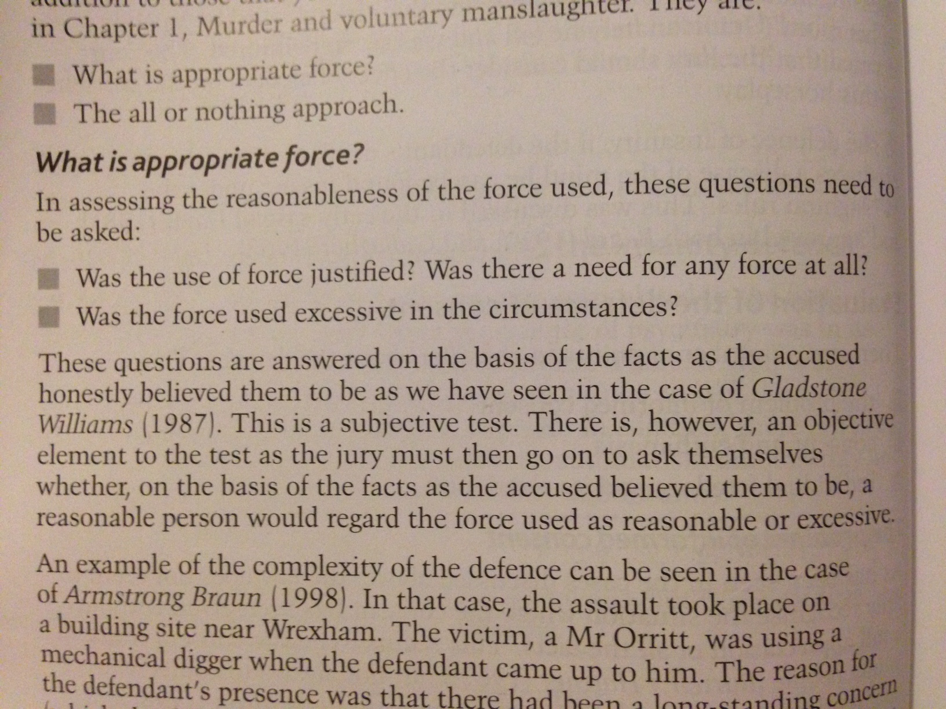
Proportionate force

Slide 43
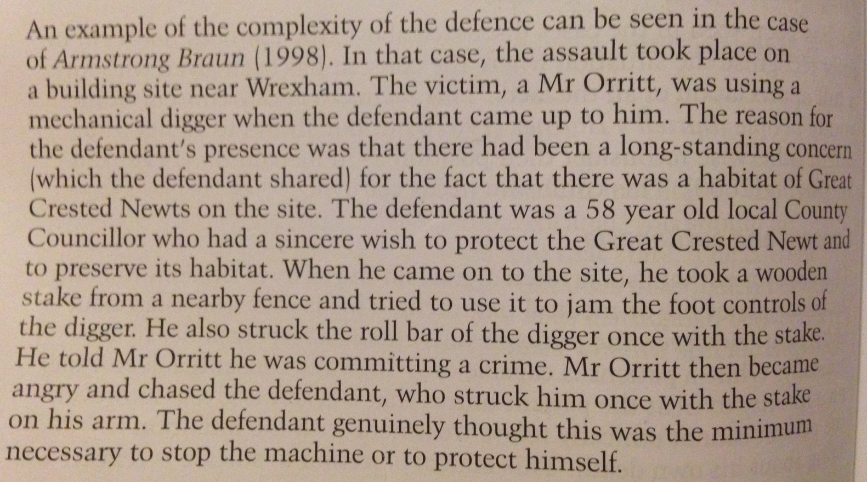
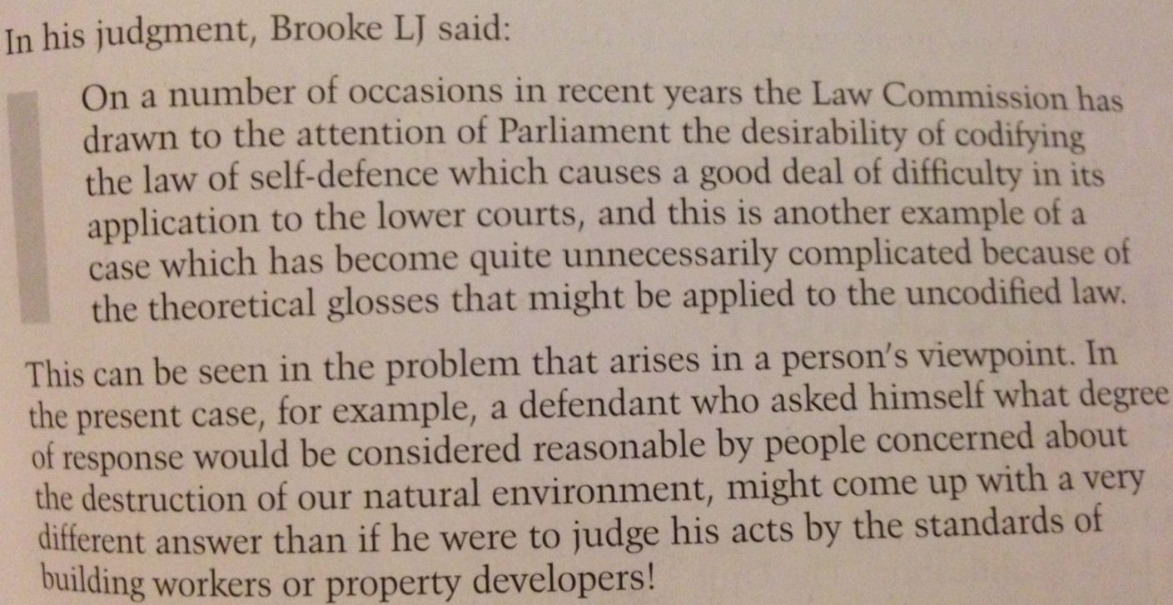

Slide 44
Reforms
Coroners and Justice Act 2009 (proportionality)
Clegg/Martin

Slide 45
All or nothing debate

Slide 46
Reforms
Same reforms as when we looked at murder:
Remove mandatory life sentence
Partial defence
CPS leaflet and Tories stating you can protect yourself in your home
Clegg/Martin

